Slide 1
Lecture 30
Chi-square tests

Slide 2
Review
1 In a matched-pairs t-test, what are the data?
the differences $d$ within each pair: a one-sample t-test on $d$, with $df=n−1$
2 Why is the paired SE usually smaller than the unpooled SE?
each pair shares a subject, so person-to-person spread cancels in $d$
3 What does the matched-pairs t-test assume?
the pairs are a random sample, and the differences are normal or $n≥30$

Slide 3
More than two categories?
So far a categorical response had two outcomes (yes or no), and we tested one $p$ or $p_{1}−p_{2}$. The Pew question has four answers, and someone claims all four are equally common among U.S. teens.
Never 289, Rarely 216, Sometimes 178, Often 60; $n=743$
(a) What kind of variable is $X$? How many categories does it have?
(b) Can a test of one proportion $p$ check the claim? Why or why not?
(a) categorical, with $k=4$ categories
(b) no: one $p$ covers one category; the claim is about all four, $p_{1},p_{2},p_{3},p_{4}$, at once

Slide 4
Tables for categorical data
one-way table
the count in each category of one categorical variable
two-way (contingency) table
the count for every combination of two categorical variables: rows × columns
marginal distribution
one variable on its own: the row or column totals, as proportions
conditional distribution
one variable within a single row (or column) of the other, as proportions

Slide 5
Data: volunteers and hours
Type of volunteer | 1–3 hours | 4–6 hours | 7–9 hours | Row total
Community college | 111 | 96 | 48 | 255
Four-year college | 96 | 133 | 61 | 290
Nonstudents | 91 | 150 | 53 | 294
Column total | 298 | 379 | 162 | 839
Adults 21 and older volunteer one to nine hours a week with a disabled senior citizen. A sample of 839 volunteers: $X$ = type of volunteer, $Y$ = hours volunteered per week. (OpenStax, Example 11.6)

Slide 6
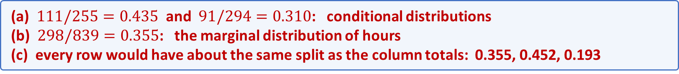
Example: do the rows look alike?
Is the number of hours volunteered related to the type of volunteer? Before any test, compare the rows of the two-way table.
1–3 hours: community college 111 of 255; nonstudents 91 of 294; everyone 298 of 839
(a) What share of community college volunteers work 1–3 hours? Of nonstudents?
(b) What share of all 839 volunteers work 1–3 hours? Which kind of distribution is each?
(c) If hours had nothing to do with type, what would the rows look like?
(a) $111/255=0.435$ and $91/294=0.310$: conditional distributions
(b) $298/839=0.355$: the marginal distribution of hours
(c) every row would have about the same split as the column totals: 0.355, 0.452, 0.193

Slide 7
Observed and expected counts
observed count $O$
the count in a category (or cell) of our data
expected count $E$
the count we would expect if $H_{0}$ is true: $E=n p_{i}$, with $p_{i}$ from $H_{0}$
the chi-square distribution
a family of right-skewed curves for values $≥0$, one for each df
degrees of freedom (one variable)
$df=k−1$, where $k$ is the number of categories

Slide 8
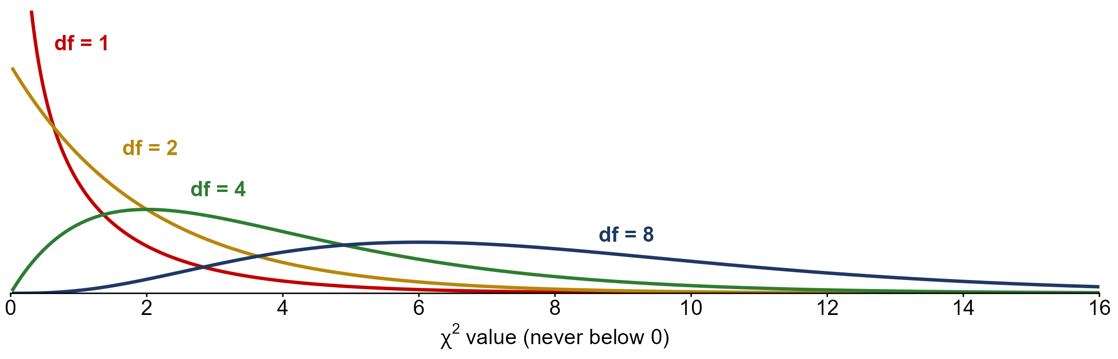
The chi-square distribution
never below 0, skewed right; mean $=df$; a larger df moves the curve right

Slide 9
The chi-square statistic
the chi-square statistic
$$X^{2}=∑\frac{(O−E)^{2}}{E}$$
added up over every category: how far each count is from what $H_{0}$ predicts
$$X^{2}=0$$
the observed counts match $H_{0}$ exactly
a large $X^{2}$
the counts are far from $H_{0}$: evidence against $H_{0}$ (always right-tailed)
if $H_{0}$ is true
$X^{2}$ is approximately $χ^{2}(k−1)$, when every $E≥5$

Slide 10
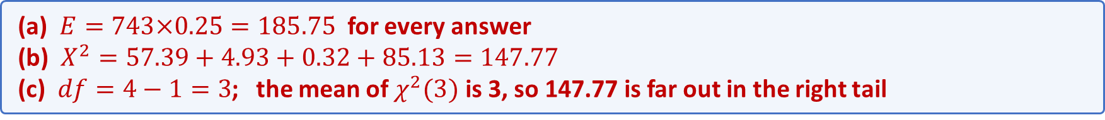
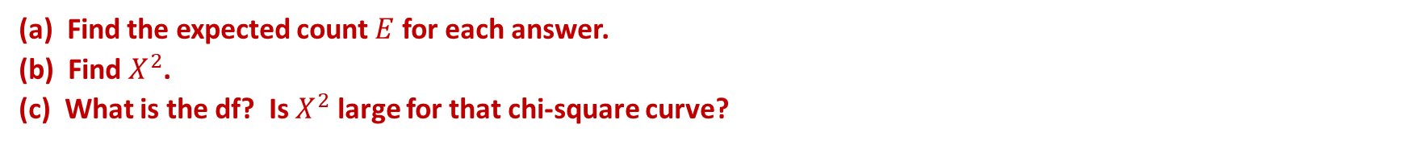
Example: equally common answers?
Back to the Pew survey. Someone claims the four answers are equally common among U.S. teens:
$$H_{0}:p_{1}=p_{2}=p_{3}=p_{4}=0.25$$
$n=743$; observed: Never 289, Rarely 216, Sometimes 178, Often 60
(a) Find the expected count $E$ for each answer.
(b) Find $X^{2}$.
(c) What is the df? Is $X^{2}$ large for that chi-square curve?
(a) $E=743×0.25=185.75$ for every answer
(b) $X^{2}=57.39+4.93+0.32+85.13=147.77$
(c) $df=4−1=3$; the mean of $χ^{2}(3)$ is 3, so 147.77 is far out in the right tail

Slide 11
The goodness-of-fit test
the question
does one categorical variable follow a claimed distribution $p_{1,0},…,p_{k,0}$?
the hypotheses
$H_{0}$: every $p_{i}=p_{i,0}$ (it fits); $H_{A}$: at least one $p_{i}≠p_{i,0}$
the expected counts
$E_{i}=n p_{i,0}$: what $H_{0}$ predicts for each category
the statistic and df
$X_{obs}^{2}=∑(O−E)^{2}/E$, with $df=k−1$
the P-value
$P(χ^{2}≥X_{obs}^{2}|H_{0} true)$: always the upper tail; needs every $E≥5$

Slide 12
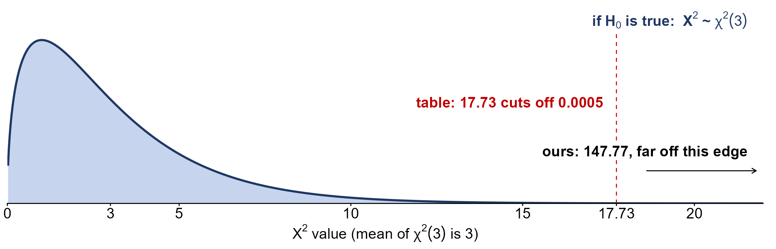
The Pew P-value
P-value < 0.0005 < $α=0.05$: reject $H_{0}$; the four answers are not equally common

Slide 13
Data: employee absences
Day | Mon | Tue | Wed | Thu | Fri | Total
Observed O | 15 | 12 | 9 | 9 | 15 | 60
A random sample of 60 managers each named the weekday on which they had the most employee absences. (OpenStax, Example 11.2)

Slide 14
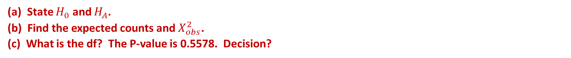
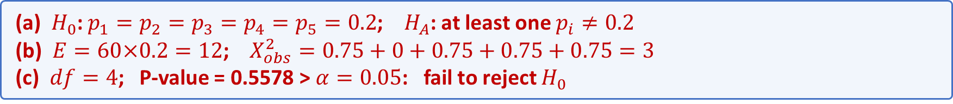
Example: equal absences?
Most employers believe employees are absent equally across a five-day week. A random sample of 60 managers named the day with the most absences. (OpenStax, Example 11.2)
Mon 15, Tue 12, Wed 9, Thu 9, Fri 15; $n=60$, $α=0.05$
(a) State $H_{0}$ and $H_{A}$.
(b) Find the expected counts and $X_{obs}^{2}$.
(c) What is the df? The P-value is 0.5578. Decision?
(a) $H_{0}$: $p_{1}=p_{2}=p_{3}=p_{4}=p_{5}=0.2$; $H_{A}$: at least one $p_{i}≠0.2$
(b) $E=60×0.2=12$; $X_{obs}^{2}=0.75+0+0.75+0.75+0.75=3$
(c) $df=4$; P-value = 0.5578 > $α=0.05$: fail to reject $H_{0}$

Slide 15
Absences: expected counts and contributions
expected: $E=n p_{i,0}=60×0.2=12$ for every day
contribution: $(O−E)^{2}/E$; Monday: $(15−12)^{2}/12=0.75$
Day | Mon | Tue | Wed | Thu | Fri | Total
Observed O | 15 | 12 | 9 | 9 | 15 | 60
Expected E | 12 | 12 | 12 | 12 | 12 | 60
Contribution | 0.75 | 0 | 0.75 | 0.75 | 0.75 | 3
$X_{obs}^{2}=0.75+0+0.75+0.75+0.75=3$, $df=5−1=4$

Slide 16
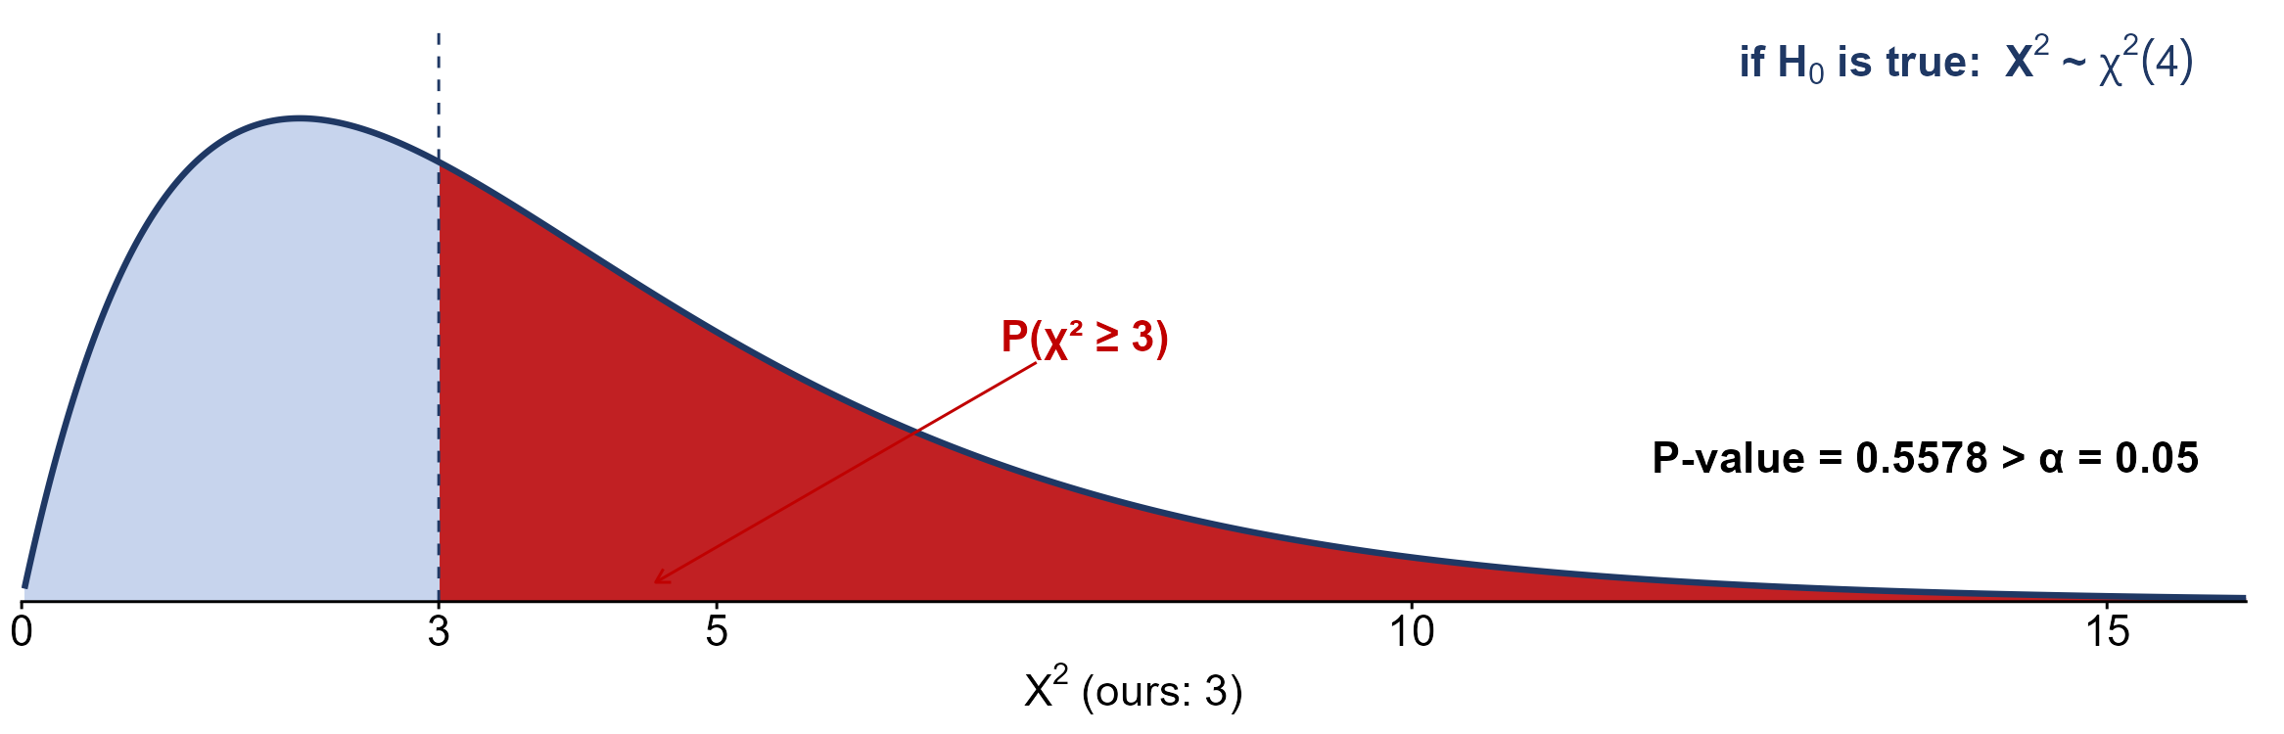
The absences P-value
P-value = 0.5578 > $α=0.05$: fail to reject $H_{0}$; no evidence that the days differ

Slide 17
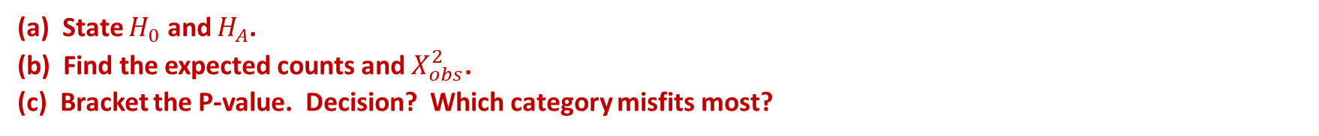
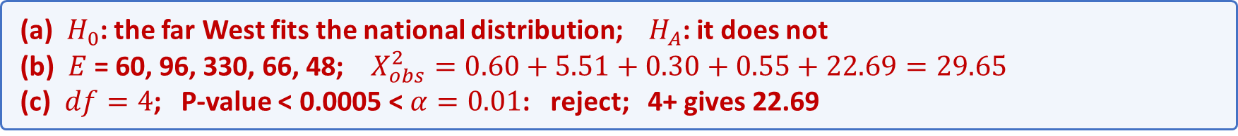
Example: streaming in the far West
A national study gives how many streaming services American families have. A random sample of 600 far-western families was asked the same. Does the far West differ? (OpenStax, Example 11.3)
services 0, 1, 2, 3, 4+: national 10%, 16%, 55%, 11%, 8%
far West observed 66, 119, 340, 60, 15; $n=600$, $α=0.01$
(a) State $H_{0}$ and $H_{A}$.
(b) Find the expected counts and $X_{obs}^{2}$.
(c) Bracket the P-value. Decision? Which category misfits most?
(a) $H_{0}$: the far West fits the national distribution; $H_{A}$: it does not
(b) $E$ = 60, 96, 330, 66, 48; $X_{obs}^{2}=0.60+5.51+0.30+0.55+22.69=29.65$
(c) $df=4$; P-value < 0.0005 < $α=0.01$: reject; 4+ gives 22.69

Slide 18
Practice: can we run the test?
Math faculty think 100 students' absences per term would be spread as below. A random survey of math courses counted actual absences. (OpenStax, Example 11.1)
absences 0-2, 3-5, 6-8, 9-11, 12+:
expected 50, 30, 12, 6, 2; observed 35, 40, 20, 1, 4
(a) Can we run a goodness-of-fit test on this table?
(b) If not, what do we do? What is the df then?
(a) no: the expected count for 12+ is 2, below 5
(b) combine 9-11 and 12+ into 9+ ($E=8$, $O=5$); $df=4−1=3$

Slide 19
The test of independence
the question
are two categorical variables, measured on one sample, related?
the hypotheses
$H_{0}$: the variables are independent; $H_{A}$: they are not (associated)
the expected counts
$E=(row total)(column total)/n$ for every cell
the statistic and df
$X_{obs}^{2}$ adds a term for every cell; $df=(r−1)(c−1)$; upper tail

Slide 20
Data: volunteers and hours (observed)
Type of volunteer | 1-3 hours | 4-6 hours | 7-9 hours | Row total
Community college | 111 | 96 | 48 | 255
Four-year college | 96 | 133 | 61 | 290
Nonstudents | 91 | 150 | 53 | 294
Column total | 298 | 379 | 162 | 839
A sample of 839 adult volunteers, classified by type of volunteer and hours volunteered per week. (OpenStax, Example 11.6)

Slide 21
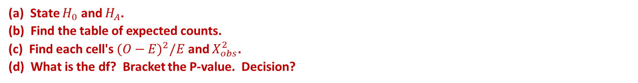
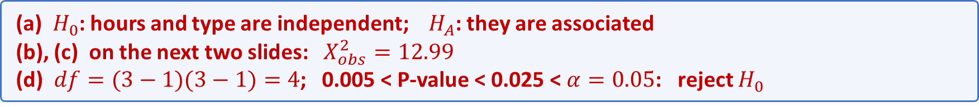
Example: volunteers and hours
Is the number of hours volunteered independent of the type of volunteer? (OpenStax, Example 11.6)
row totals 255, 290, 294; column totals 298, 379, 162; $n=839$, $α=0.05$
(a) State $H_{0}$ and $H_{A}$.
(b) Find the table of expected counts.
(c) Find each cell's $(O−E)^{2}/E$ and $X_{obs}^{2}$.
(d) What is the df? Bracket the P-value. Decision?
(a) $H_{0}$: hours and type are independent; $H_{A}$: they are associated
(b), (c) on the next two slides: $X_{obs}^{2}=12.99$
(d) $df=(3−1)(3−1)=4$; 0.005 < P-value < 0.025 < $α=0.05$: reject $H_{0}$

Slide 22
Volunteers: expected counts
$E=(row total)(column total)/n$; community college, 1-3 hours: $255×298/839=90.57$
Expected E | 1-3 hours | 4-6 hours | 7-9 hours | Row total
Community college | 90.57 | 115.19 | 49.24 | 255
Four-year college | 103.00 | 131.00 | 56.00 | 290
Nonstudents | 104.42 | 132.81 | 56.77 | 294
Column total | 298 | 379 | 162 | 839
every $E≥5$; each row of $E$ adds to its row total

Slide 23
Volunteers: each cell's contribution
contribution $=(O−E)^{2}/E$; community college, 1-3 hours: $(111−90.57)^{2}/90.57=4.607$
Contribution | 1-3 hours | 4-6 hours | 7-9 hours
Community college | 4.607 | 3.197 | 0.031
Four-year college | 0.476 | 0.030 | 0.447
Nonstudents | 1.726 | 2.225 | 0.250
$$X_{obs}^{2}=4.607+3.197+0.031+0.476+0.030+0.447+1.726+2.225+0.250=12.99$$

Slide 24
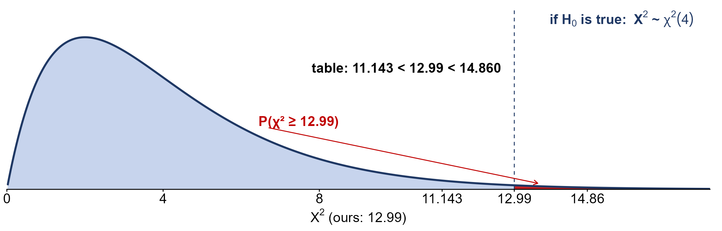
The volunteers P-value
0.005 < P-value < 0.025 < $α=0.05$: reject $H_{0}$; hours depend on the type of volunteer

Slide 25
Data: anxiety and need to succeed
Need / anxiety | High | Med-high | Medium | Med-low | Low | Total
High | 35 | 42 | 53 | 15 | 10 | 155
Medium | 18 | 48 | 63 | 33 | 31 | 193
Low | 4 | 5 | 11 | 15 | 17 | 52
Total | 57 | 95 | 127 | 63 | 58 | 400
A random sample of 400 De Anza College students took a test measuring their anxiety level and their need to succeed in school. (OpenStax, Example 11.7)

Slide 26
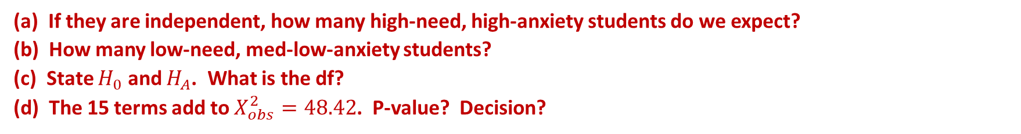
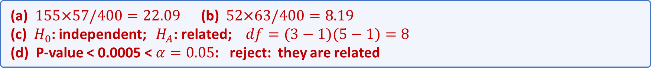
Practice: anxiety and need to succeed
De Anza College wants to know whether anxiety level and the need to succeed in school are related.
$n=400$; smallest expected count 7.41; $α=0.05$
(a) If they are independent, how many high-need, high-anxiety students do we expect?
(b) How many low-need, med-low-anxiety students?
(c) State $H_{0}$ and $H_{A}$. What is the df?
(d) The 15 terms add to $X_{obs}^{2}=48.42$. P-value? Decision?
(a) $155×57/400=22.09$ (b) $52×63/400=8.19$
(c) $H_{0}$: independent; $H_{A}$: related; $df=(3−1)(5−1)=8$
(d) P-value < 0.0005 < $α=0.05$: reject: they are related

Slide 27
The test for homogeneity
the question
do two or more populations have the same distribution of one categorical variable?
the design
a separate random sample from each population: one row per population
the hypotheses
$H_{0}$: the distributions are the same; $H_{A}$: they are not all the same
the math
the same as independence: $E=(row total)(column total)/n$, $df=(r−1)(c−1)$

Slide 28
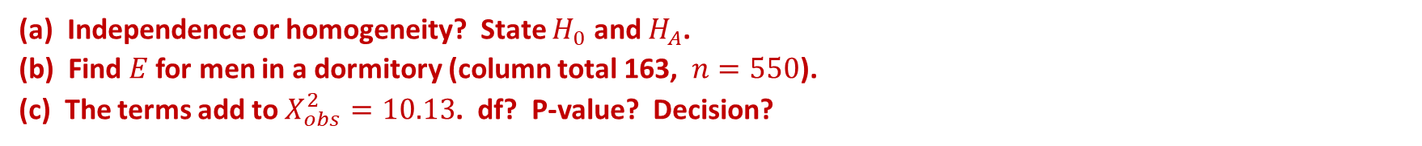
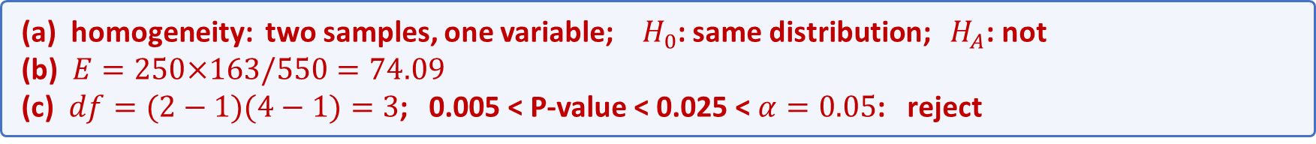
Example: living arrangements
250 randomly selected men and 300 randomly selected women college students were asked where they live. Do men and women have the same distribution of living arrangements? (OpenStax, Example 11.8)
dormitory, apartment, with parents, other:
men 72, 84, 49, 45; women 91, 86, 88, 35; $α=0.05$
(a) Independence or homogeneity? State $H_{0}$ and $H_{A}$.
(b) Find $E$ for men in a dormitory (column total 163, $n=550$).
(c) The terms add to $X_{obs}^{2}=10.13$. df? P-value? Decision?
(a) homogeneity: two samples, one variable; $H_{0}$: same distribution; $H_{A}$: not
(b) $E=250×163/550=74.09$
(c) $df=(2−1)(4−1)=3$; 0.005 < P-value < 0.025 < $α=0.05$: reject

Slide 29
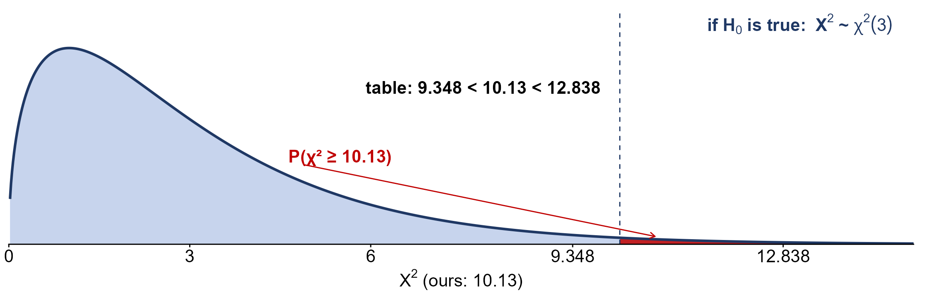
The living-arrangements P-value
P-value = 0.0175 < $α=0.05$: reject; women live with parents more (0.293 vs 0.196)

Slide 30
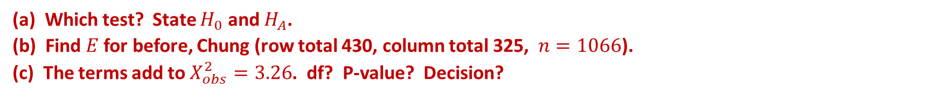
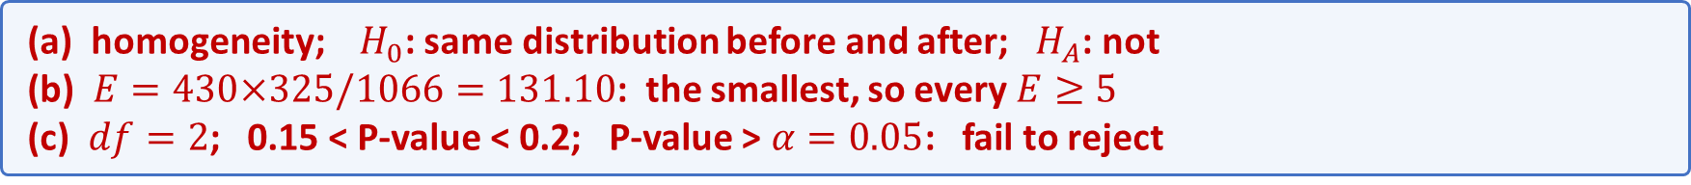
Practice: voters and the earthquake
Before and after a recent earthquake, separate surveys asked voters which of three city-council candidates they planned to vote for. Did preferences change? (OpenStax, Example 11.9)
Perez, Chung, Stevens:
before 167, 128, 135; after 214, 197, 225; $α=0.05$
(a) Which test? State $H_{0}$ and $H_{A}$.
(b) Find $E$ for before, Chung (row total 430, column total 325, $n=1066$).
(c) The terms add to $X_{obs}^{2}=3.26$. df? P-value? Decision?
(a) homogeneity; $H_{0}$: same distribution before and after; $H_{A}$: not
(b) $E=430×325/1066=131.10$: the smallest, so every $E≥5$
(c) $df=2$; 0.15 < P-value < 0.2; P-value > $α=0.05$: fail to reject

Slide 31
Which chi-square test?
1 Bags are said to be 20% of each of five colors; you count 300 candies.
goodness of fit: one variable vs a claim; $E=60$ per color, $df=4$
2 500 voters give their age group and their main news source.
independence: one sample, two variables on each voter
3 200 first-years and 200 seniors say how they get to campus.
homogeneity: two separate samples, one variable; $df=(2−1)(4−1)=3$

Slide 32
Summary: the three chi-square tests
goodness of fit
one sample, one variable vs a claim: $E=n p_{i,0}$, $df=k−1$
independence
one sample, two variables: $E=(row total)(column total)/n$, $df=(r−1)(c−1)$
homogeneity
one sample per population, one variable: the same $E$ and df as independence
all three
$X_{obs}^{2}=∑(O−E)^{2}/E$; upper tail; every $E≥5$

